Slide 1
Predictive maintenance for remote field devices

Slide 2
Creating accessible content
Take the following steps to create accessible content that everyone can consume effectively.
Contrast
Use high contrast colors for maximum readability
The recommended contrast ratio is at least 4.5:1
Color Contrast Analyzer
Download this tool to determine the legibility of text and the contrast of visual elements
Shape and color
Use different shapes with a legend to indicate statuses to accommodate for color blindness
Example:
Alt text
Alt text helps people with screen readers understand the content of slides
You can create alternative text for shapes, pictures, charts, tables, SmartArt graphics, or other objects
Here’s how:
Right click the image or shape
Select Format Picture… or Format Shape…
Select the Size & Properties icon
Expand the Alt Text field
Enter a Title and Description of your image or object
Slide layouts
Using a built-in slide layout that matches your content ensures a hierarchical reading order of text blocks
Example:
If a new slide will have a title, rather than starting with a blank layout and adding a text block for the title, choose one of the built-in layouts with a title placeholder
Reading order
Screen readers describe content on the screen in the order it was created
To ensure your content is read back in the order you prefer, arrange your objects in the Selection Pane appropriately. Objects on the bottom of the selection pane are read first
Here’s how:
Click the Home tab
In the Drawing group, select the Arrange drop-down menu
Click Selection Pane…
Text
Text
Text
Subject 1
Subject 2
Subject 3
Download
C1
C2
C3
Additional tips!
Be sure to run the Accessibility Checker! Go to File click the Check for Issues drop down menu click Check Accessibility
Videos need to be accessible: If your presentation includes a video, ensure it is captioned and audio described (if appropriate)
Visit the Office Accessibility Center to learn more about accessibility in PowerPoint

Slide 3

Abstract and learning objectives
Fabrikam, Inc. creates innovated IoT solutions for the oil and gas manufacturing industry. It is beginning work on a new, predictive maintenance solution that targets rod pumps (the iconic pivoting pumps that dot oil fields around the world). With their solution in place, companies will be able to monitor and configure pump settings and operations remotely, and only send personnel onsite when necessary for repair or maintenance when the solution indicates that something has gone wrong. However, Fabrikam wants to go beyond reactive alerting- they want to want to enable the solution with the ability to predict problems so they can be averted before a fault occurs and damage is done.
At the end of this whiteboard design session, you will be better able to design a solution to manage IoT devices, ingest and visualize telemetry from these devices, and proactively predict maintenance through custom-trained ML models.

Slide 4
Step 1: Review the customer case study
Outcome
Analyze your customer needs
Timeframe
15 minutes

Slide 5
Customer situation
Fabrikam creates innovative solutions for the oil and gas industry. They are working on a new predictive maintenance solution for fuel rod pumps.
They want to predict problems so they can be averted before a fault occurs and damage is done.
One challenge is managing IoT devices at scale and securely.
Notes:
Fabrikam, Inc. creates innovative IoT solutions for the oil and gas manufacturing industry. It is beginning work on a new, predictive maintenance solution that targets rod pumps (the iconic pivoting pumps that dot oil fields around the world). With their solution in place, companies will be able to monitor and configure pump settings and operations remotely, and only send personnel onsite when necessary for repair or maintenance when the solution indicates that something has gone wrong. However, Fabrikam wants to go beyond reactive alerting- they want to want to enable the solution with the ability to predict problems so they can be averted before a fault occurs and damage is done.
One of Fabrikam's challenges is managing IoT devices at scale. They want to be able to securely store credentials on their devices before sending them to their customers. When the devices connect to the cloud, they want to have an approval process that activates those devices so they can start sending telemetry securely. All data in transit must be encrypted.

Slide 6
Customer situation
Fabrikam does not have IoT expertise, so they want to evaluate both SaaS and PaaS IoT options in Azure.
They want to build a proof of concept that includes device management, visualization, reporting, control, monitoring, and predictions using a Machine Learning (ML) model.
They want to see if building on SaaS will meet their needs and be scalable and secure.
Notes:
Another decision point for Fabrikam is whether they would benefit from a software-as-a-service (SaaS) cloud-based offering, or a more customized platform-as-a-service (PaaS) solution. Fabrikam's technical leadership believes that, since IoT is not one of their top disciplines, and because technology is rapidly changing in the IoT space, they would benefit most from a SaaS-based solution. On the other hand, they want to know what the range of IoT PaaS options there are on Azure so they can make an informed decision on which route they should invest their time and resources. Given their current lack of IoT experience, Fabrikam would like to build a proof of concept using a SaaS product that they can quickly get started with to evaluate whether it meets their immediate and long-term needs. These needs include device management, visualization, reporting, control, and monitoring. Ideally, the solution will be highly scalable and secure, should they decide to transition from a PoC to a pilot deployment with several customers. When they do start expanding to several customers, they would like a transparent pricing structure they can use to project costs and pass those costs to their customers based on their usage.

Slide 7
Customer situation
How can they visualize all the telemetry data generated by sensors on each rod pump? These include power output from motors, motor speed, pump rate in strokes per minute, how long the pump is on, and casing friction, to name a few.
They want to build meaningful dashboards and charts with all this information and show in groups of pumps in the same location.
Are there simple low-code solutions for this?
Notes:
Whichever cloud-based solution Fabrikam pursues, they want to know how they can visualize all of the data generated by sensors on each rod pump. These sensors include power output from motors, motor speed, the pump rate measured in strokes per minute, how long the pump is on, and casing friction measured in psi, to name a few. Each of these sensors output data at different rates and measurements, complicating any effort to build meaningful charts and dashboards. The information needs to be easily digested by analysts and technicians alike, with options to filter and explore the data over a timeline and within groups (oil pumps located within the same oil field). Ideally, there will be a customizable dashboard that shows crucial information at a glance. Fabrikam wants to know if there are out-of-the-box solutions for creating these visualizations and dashboards without involving developers and other IT staff.

Slide 8
Customer situation
Fabrikam has historical data for pumps operating normally, ones that gradually fail, and pumps that have immediate failures.
They want to train an ML model with this data and be able to periodically re-train the model with new data.
The model should predict whether a pump needs to be maintained, in real time.
Send alerts to engineers/supervisors if maintenance or failure predicted.
Notes:
Fabrikam has collected and compiled thorough maintenance and operational data of rod pump components, creating separate data sets for pumps operating under normal conditions, during gradual mechanical failure, and during periods of immediate failure. Each of the elements of the rod pump's mechanism generates a consistent pattern in their telemetry when operating under normal conditions. If one of these components starts to degrade or suffers an operational failure, the signal reflects this change in status. Fabrikam would like to use this historical data to train a Machine Learning (ML) model to predict when a pump needs to be maintained. They want to use this trained model to make predictions in real time, based on telemetry from their pumps' sensors. If the model predicts a pump needs to be maintained, they would like to automatically send an alert to engineers and field pump supervisors so they can potentially mitigate the issue and prevent damage to the failing and related components. In many cases, the fuel rod's onboard controller can modify the operating parameters of the pump to avoid or mitigate the impact of unexpected changes. Alternatively, if necessary, it can shut down the pump before any damage occurs and notify the company that repairs are necessary—protecting the machinery, and preventing potential environmental damage. Fabrikam would like to have a mechanism within their solution to send commands to rod pump controllers to modify these operating parameters remotely.

Slide 9
Customer situation
Predictive models should increase operator efficiency and safety. The average downtime due to maintenance issues costs up to $20,000 USD/day and minimum of 3 days outage.
Proactively identifying pump problems through predictive analytics should decrease costs and increase production.
They want to be able to send commands to rod pump controllers remotely to modify operating parameters.
Notes:
Their goal in the use of such predictive models is to increase operator efficiency and safety. Addressing a typical maintenance issue takes several people and at least three days of system downtime at a cost of up to $20,000 USD a day, not including parts and labor. "By proactively identifying pump problems through predictive analytics, companies reduce unplanned downtime, which decreases costs, increases production, and increases the agility of maintenance services." says Fabrikam's Chief Engineer, Peter Guerin. He adds that the majority of industry accidents don’t happen at the well site, they happen when personnel are driving between sites. By eliminating the need for many site visits, they can reduce those accidents.
They would like to understand their options for expediting the implementation of the PoC. Specifically, they are looking to learn what offerings Azure provides that could enable a quick end-to-end start on the infrastructure for monitoring and managing devices and the system metadata. On top of this, they are curious about what other platform services Azure provides that they should consider in this scenario.
They would like to start by building a proof of concept that performs the predictive analytics in the cloud. While their machine learning will initially happen in the cloud, they would like to design their solution with an eye towards the future so it could be enhanced to run the models at the edge.

Slide 10
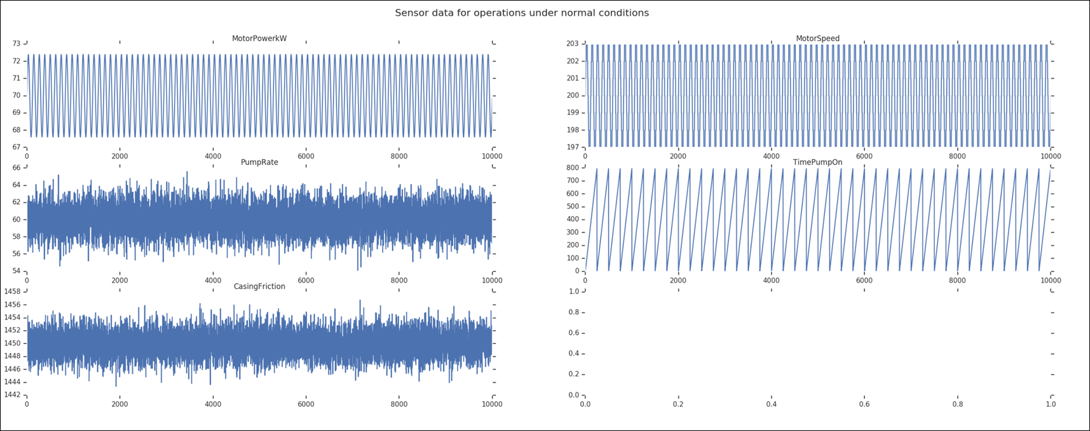
Telemetry data – normal operation
Notes:
Normal signal readings from five sensors appear in the chart, with 10,000 intervals. The frequency of the output is condensed to fit.

Slide 11
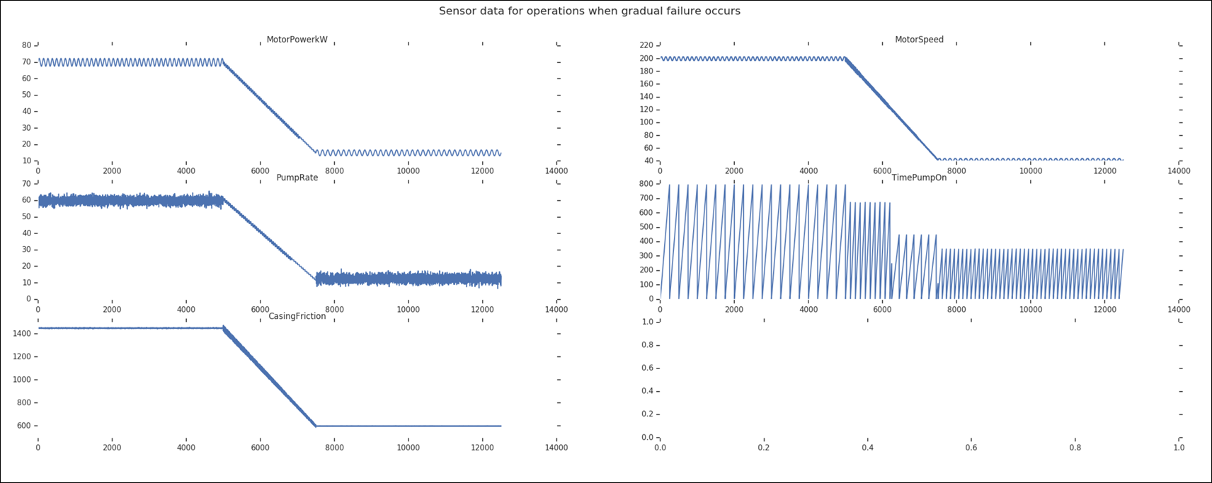
Telemetry data – gradual failure
Notes:
The chart shows the telemetry for these five components during a gradual failure. In many cases, there is time to react and prevent total failure through remote commands to the pump controller.

Slide 12
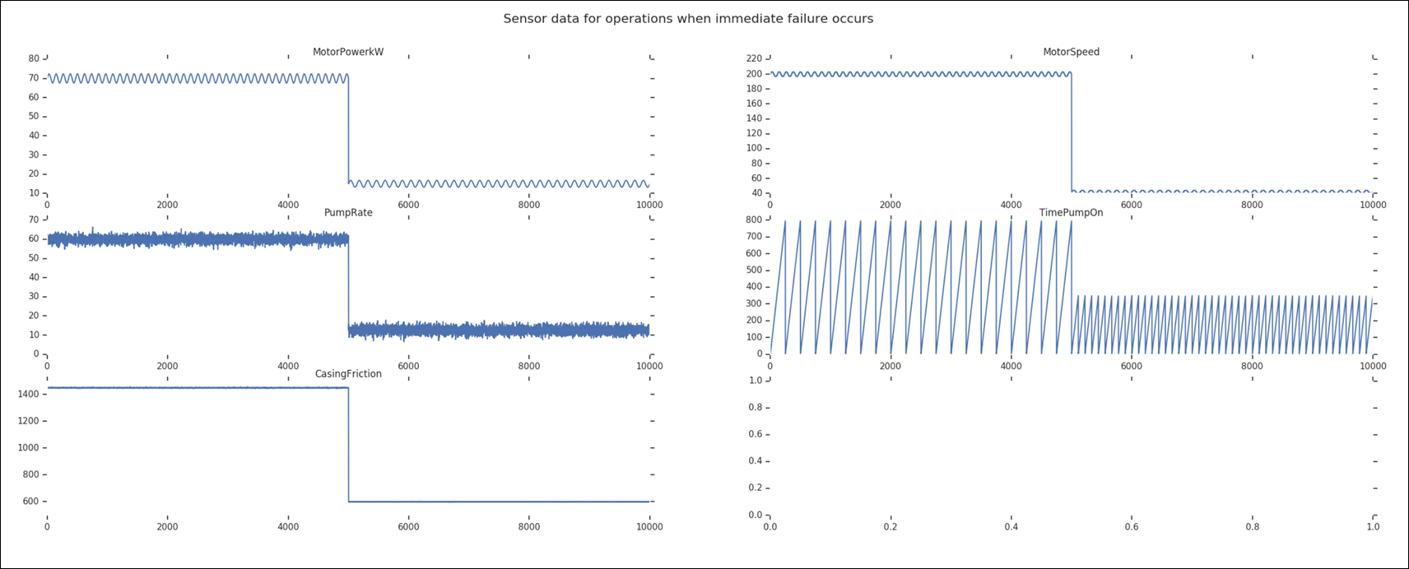
Telemetry data – immediate failure
Notes:
This final chart shows the telemetry for these five components when there is an immediate failure.

Slide 13
Customer needs
Compare SaaS and PaaS-based offerings on Azure, then determine which is best for a rapid PoC
Need simple web-based access to metadata management of rod pump devices by our users
Need to be able to add new IoT devices in bulk
Need configurable standard dashboards for all users and personalized dashboards
Collect and export real-time telemetry at scale. Intuitive interface to analyze fresh and historical data within timelines
Notes:
We are interested in comparing SaaS and PaaS-based offerings on Azure. Based on our needs, will a SaaS solution meet our needs for a rapid PoC?
Need web-based access to metadata management of the rod pump devices for simplified management by our users.
When we expand beyond the PoC, we need to be able to add devices in bulk for our customers.
We would like to have configurable standard dashboards for all users and personalized dashboards.
Need collection and export of real-time telemetry, at scale. There should be an intuitive interface for analyzing collected data as it arrives, or within timelines to include historical information.

Slide 14
Customer needs
Strong device security with encryption in transit and at rest + ample cloud-based security & user management
Use historical pump data to train Machine Learning (ML) model for real-time predictive maintenance
Periodically re-train model with new data
Configure alerts when ML model predicts failure so engineers can take action and send remote commands to pump controllers to prevent damage due to failure
Alert options flexible for choosing destination and executing automated tasks
Notes:
Require strong device security with encryption at transit and at rest, as well as ample cloud-based security and user management.
We want to use historical pump data to train a Machine Learning (ML) model to predict in real time whether a pump should be maintained to prevent failure. We'd like to periodically re-train the model with new data.
We want to configure alerts when the ML model predicts failure so engineers can take action and send remote commands to pump controllers to prevent damage due to mechanical failure. Alert options should be flexible for choosing a destination and executing automated tasks.

Slide 15

Customer objections
Is there an out of the box solution we can use to jump-start the creation of the solution?
We are worried about being constrained by a "black box" if we go with a SaaS solution. Do we have access to all of our collected telemetry we can use for external workloads?
Notes:
Is there an out of the box solution we can use to jump-start the creation of the solution?
We are worried about being constrained by a "black box" if we go with a SaaS solution. Do we have access to all of our collected telemetry we can use for external workloads?

Slide 16
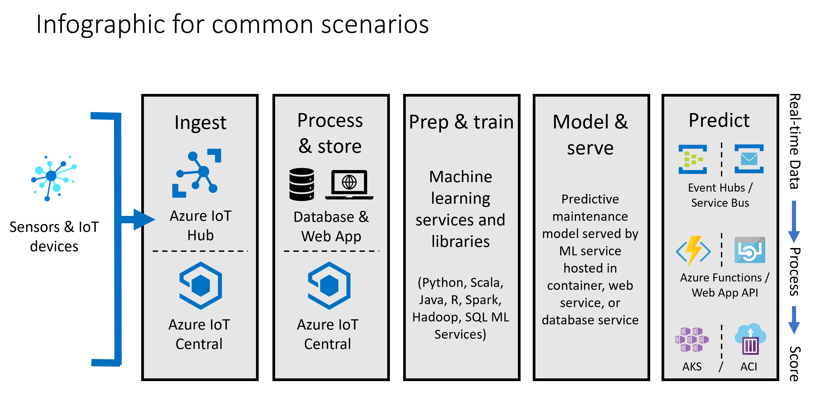
Common scenarios

Slide 17
Step 2: Design the solution
Outcome
Design a solution and prepare to present the solution to the target customer audience in a 15-minute chalk-talk format.
Timeframe
60 minutes
Business needs (10 minutes) | Respond to questions outlined in your guide and list the answers on a flipchart
Design (35 minutes) | Design a solution for as many of the stated requirements as time allows. Show the solution on a flipchart
Prepare (15 minutes) | Identify any customer needs that are not addressed with the proposed solution Identify the benefits of your solution Determine how you will respond to the customer’s objections Prepare for a 15-minute presentation to the customer

Slide 18
Step 3: Present the solution
Outcome
Present a solution to the target customer in a 15-minute chalk-talk format
Timeframe
30 minutes (15 minutes for each team to present and receive feedback)
Directions
Pair with another table
One table is the Microsoft team and the other table is the customer
The Microsoft team presents their proposed solution to the customer
The customer asks one of the objections from the list of objections in the case study
The Microsoft team responds to the objection
The customer team gives feedback to the Microsoft team

Slide 19
Wrap-up
Outcome
Identify the preferred solution for the case study
Identify solutions designed by other teams
Timeframe
15 minutes

Slide 20

Preferred target audience
Peter Guerin, Chief Technology Officer, Fabrikam, Inc.
The primary audience is business decision makers and technology decision makers.
Usually, we talk to the Database Administrators and Infrastructure Managers who report into the CIOs, or to application sponsors (like a VP LOB, CMO) or to those that represent the Business Unit IT or developers that report into application sponsors.

Slide 21
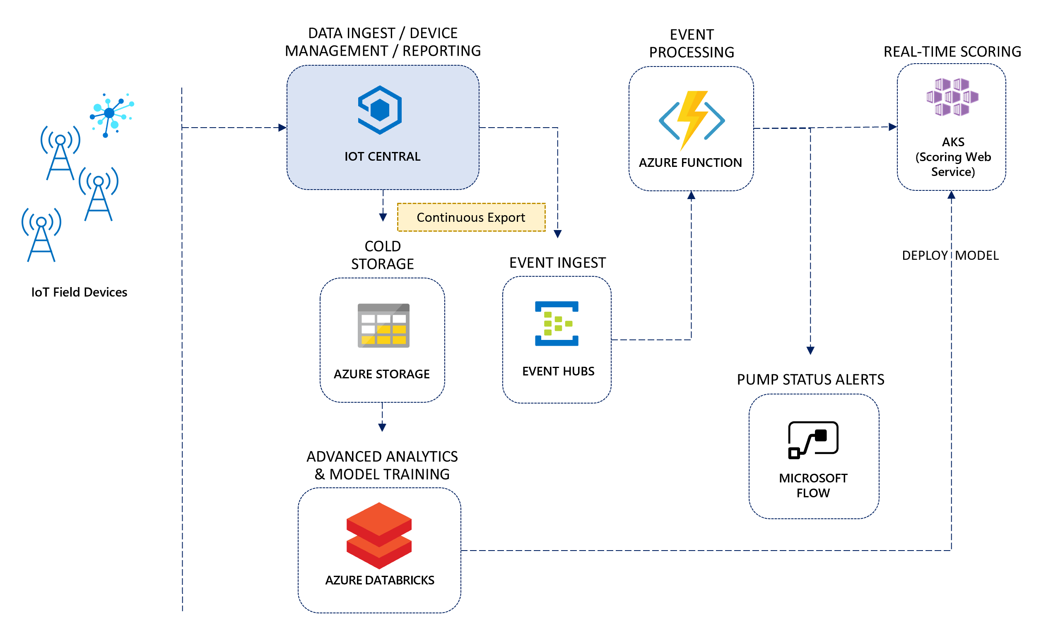
Preferred solution
Notes:
Azure IoT Central is at the core of the preferred solution. It is used for data ingest, device management, data storage, and reporting. IoT field devices securely connect to IoT Central through its cloud gateway. The continuous export component sends device telemetry data to Azure Blob storage for cold storage, and the same data to Azure Event Hubs for real-time processing. Azure Databricks uses the data stored in cold storage to periodically re-train a Machine Learning (ML) model to detect oil pump failures. It is also used to deploy the trained model to a web service hosted by Azure Kubernetes Service (AKS) or Azure Container Instances (ACI), using Azure Machine Learning service. An Azure function is triggered by events flowing through Event Hubs. It sends the event data for each pump to the web service hosting the deployed model, then sends an alert through Microsoft Flow if an alert has not been sent within a configurable period of time. The alert is sent in the form of an email, identifying the failing oil pump with a suggestion to service the device.

Slide 22
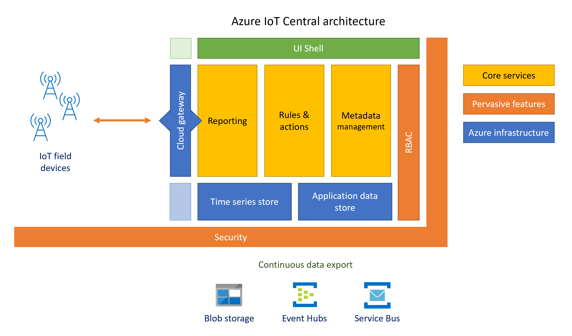
Preferred solution
Notes:
The diagram above shows the components of IoT Central's architecture that pertain to Fabrikam's use case. Because it is a SaaS-based solution, the Azure services IoT Central uses are hidden from view. IoT field devices securely connect to IoT Central through its cloud gateway. The gateway uses Azure IoT Hub Device Provisioning Service (DPS) to streamline device management, and the underlying IoT Hub service facilitates bi-directional communication between the cloud and IoT devices. All device telemetry is stored in a time series data store, based on Azure Time Series Insights. The application data store persists the IoT Central application and its customizations. This application provides a user interface shell, through which Fabrikam's users manage devices and associated metadata, view dashboards and reports, and configure rules and actions to react to device telemetry that indicates possible rod pump failure. Pervasive throughout the end-to-end solution is security in transit and at rest for devices and the web-based management application. The continuous data export feature is used to enable hot and cold path workloads on real-time and batch device telemetry and metadata, using external services. Batch data is exported to Azure Blob storage in Apache Avro file format each minute, and real-time data is exported to either Azure Event Hubs or Azure Service Bus.

Slide 23


Preferred solution
IoT options in Azure
IoT Central = SaaS
End-to-end IoT solution with the most common features without requiring cloud-based development expertise
Most configuration done via web interface
Create device templates that are versioned
IoT Hub = PaaS
Offers greater flexibility, but you are responsible for processing events, storing the data, and creating visualizations
Can use all available features of IoT Hub, such as bi-directional communication with IoT Edge devices and custom routes
Use IoT solution accelerators to jump-start custom development
Notes:
What are the SaaS-based IoT options in Azure?
Azure IoT Central is an end-to-end SaaS solution that provides the most common features used in a broad range of IoT solutions without requiring cloud-based development expertise. Most of the configuration can be done through the provided web-based UI, and device management follows a model-based approach where device templates are created to define IoT device metadata for simplified management. Devices are added to a device set that is based on a version of the template, organizing like-devices for reporting and management. Although IoT Central uses several Azure services under the covers, such as IoT Hub, those details are hidden from the user, allowing them to focus on customizing their personalized IoT Central application through its innovative UI.
What are the PaaS-based IoT options in Azure?
Azure IoT Hub is a PaaS service that allows users to connect and manage millions of IoT devices, ingest millions of events per second from these devices, automate IoT device provisioning, and cloud-to-device messaging for command and control. IoT Hub also helps enforce security on devices through per-device identity, allowing operators and admins to authorize and revoke device connections. Azure IoT solution accelerators are packaged solutions built on top of IoT Hub and other Azure components to kick-start PaaS-based IoT projects. When using Azure IoT solution accelerators, you have access to the underlying Azure services of the solution as well as the source code that comes with the starter solution. The flexibility level is high, but so is the skill level to customize the accelerator to your needs.
Both IoT Central and Azure IoT solution accelerators use IoT Hub along with other Azure services. However, these are not needed to use IoT Hub by itself in your own custom solution.

Slide 24
Preferred solution
IoT options in Azure – SaaS or PaaS?
Recommendation for Fabrikam: SaaS
They stated their interest in SaaS due to lack of expertise
IoT Central provides predictive per-device pricing
Reduces the device management burden through an intuitive interface and simplified device registration flow
Reduces operational costs and overhead by abstracting away the underlying architecture
Uses industry-leading services on Azure without requiring deep knowledge of these components, such as Azure IoT Hub and Azure Time Series Insights (time-series data store)
Automatically provides end-to-end encryption, X.509 CA certificate management, user management, and other security features
Notes:
Would you recommend SaaS or PaaS for this customer situation? What are the pros and cons of each?
Fabrikam stated their interest in a SaaS-based solution that provides a fully managed, end-to-end IoT solution without required cloud-based IoT architecture and development expertise. Azure IoT Central's features meet the base requirements for their PoC, and can easily scale to manage and ingest telemetry from millions of devices. Also, IoT Central provides a straightforward and predictable, device-based pricing structure. This pricing structure allows them to project costs and provide a transparent breakdown of fees to their customers.
When compared to using PaaS-based options for Fabrikam's IoT project, IoT Central offers the following benefits:
It reduces the device management burden through an intuitive interface and simplified device registration flow.
Reduces operational costs and overhead by abstracting away the underlying architecture, allowing Fabrikam to focus on customizing the application, managing devices, and writing device application code.
Uses industry-leading services on Azure without requiring deep knowledge of these components, such as Azure IoT Hub and Azure Time Series Insights (time-series data store).
Automatically provides end-to-end encryption, X.509 CA certificate management, user management, and other security features.

Slide 25
Preferred solution
IoT options in Azure – SaaS or PaaS?
Things to consider when using SaaS
The primary drawback is limited flexibility because the underlying infrastructure is not customizable since its components are not exposed
Fabrikam will need to find workarounds if ever their requirements change, and they need customization beyond what is provided by IoT Central's interface and SDK.
Although all the data is stored within a time-series data store, you only have access to it either through IoT Central's UI, which offers flexible filtering and visualizations, or by enabling continuous export of data to Azure Storage, Azure Event Hubs, or Azure Service Bus. You cannot directly query the datastore from an external application
Notes:
There are some drawbacks to using IoT Central, as with any SaaS-based solution. The primary drawback is limited flexibility because the underlying infrastructure is not customizable because its components are not exposed. Fabrikam will need to find workarounds if ever their requirements change, and they need customization beyond what is provided by IoT Central's interface and SDK. Another limiting factor is how data is accessed. Although all the data is stored within a time-series data store, you only have access to it either through IoT Central's UI, which offers flexible filtering and visualizations, or by enabling continuous export of data to Azure Storage, Azure Event Hubs, or Azure Service Bus. You cannot directly query the datastore from an external application.
Fabrikam could opt to create an IoT solution from scratch with IoT Hub and their own web applications and related services, or start with an Azure IoT solution accelerator for maximum flexibility. If they go this route, they have full control over the development and deployment lifecycle of their solution, including automated deployments to development, staging, and production environments. The primary drawbacks to this approach are increased time to develop and deploy the solution, required expertise for end-to-end IoT development and customization, and a more opaque pricing structure where they must fine-tune the services to control costs.

Slide 26
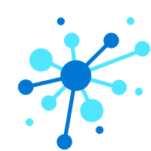
Preferred solution
Device and metadata management
Connect one device at a time with Azure IoT Hub Device Provisioning Service (DPS)
Step 1: Create a device template in IoT Central for metadata
Step 2: Select the template and add new real device
Step 3: Select real device in IoT Central, click Connect to display connection details, Scope ID, Device ID, and Device Primary Key
Use the dps-keygen command-line key generator utility to generate the shared access signature (SAS) connection string: dps-keygen -di:<Device ID> -dk:<Primary or Secondary Key> -si:<Scope ID>
Notes:
How do you connect devices one at a time?
Connect single devices for rapid testing and building small proofs of concept. Since Azure IoT Central uses Azure IoT Hub under the covers, you use the Azure IoT Hub Device Provisioning Service (DPS) to manage device registration and connections.
The first step is to create a device template in IoT Central. This template defines the device metadata, such as properties and telemetry fields, that are common to one or more IoT devices you connect to IoT Central. The next step is to select the template and add a new real device. The options here are to add a simulated device that IoT Central manages and uses to generate simulated telemetry or a real device. Real devices represent IoT devices that you connect to IoT Central through application code, or credentials flashed to the device. Finally, select the real device in IoT Central and click Connect to display the connection details, Scope ID, Device ID, and Device Primary key. These values are used with the dps-keygen command-line key generator utility to generate a shared access signature (SAS) connection string:
dps-keygen -di:<Device ID> -dk:<Primary or Secondary Key> -si:<Scope ID>
Use the connection string on your device to connect to IoT Central.

Slide 27
Preferred solution
Device and metadata management
Securely connect multiple devices at scale
Option 1 (testing/development): use SAS connection strings
Use the dps-keygen command-line key generator along with the device group primary key to create Device IDs in bulk: dps-keygen –mk:<Primary_Key>(GroupSAS)> -di:<Device ID>
Flash each IoT device with the Scope ID, Device ID, and generated SAS key
When turned on, the device will connect to DPS to retrieve its IoT Central registration info, then connect to the IoT Central application
Notes:
How do you connect multiple devices at scale? What options are there to secure device connections?
Option 1 (testing/development): use SAS connection strings
SAS device keys are generated using the dps-keygen command-line key generator utility, along with the group Primary Key value from the Device Connection page under Administration in IoT Central, and the unique, lower-case Device ID for each device you add in bulk:
dps-keygen -mk:<Primary_Key(GroupSAS)> -di:<device_id>
Flash each IoT device with the Scope ID (also found in the Device Connection page), Device ID, and the generated SAS key. When turned on, the device will connect to DPS to retrieve its IoT Central registration information, then connect to the IoT Central application.

Slide 28
Preferred solution
Device and metadata management
Securely connect multiple devices at scale
Option 2 (production): X.509 Certificate Authority (CA) auth
Simplifies device identity creation and life-cycle management in the supply chain
Register the X.509 CA certificate once by generating a public/private key pair and signing the public key into the certificate
Fabrikam can cryptographically sign intermediate CAs for each manufacturer working on part of the hardware components
Add the X.509 root or intermediate certificate under the Device Connection page in IoT Central, then verify the certificate by generating a verification code to create an X.509 verification certificate. This certifies Fabrikam is the owner.
Create leaf certificates with the Device ID as the CNAME value and add unique certificate to each device
Notes:
How do you connect multiple devices at scale? What options are there to secure device connections?
Option 2: X.509 Certificate Authority (CA) authentication simplifies device identity creation and life-cycle management in the supply chain. This is because X.509 CA certificate has a one-to-many relationship with its downstream services by registering all of your devices with IoT Hub (and by extension, IoT Central) by registering the X.509 CA certificate once. To create a certificate, Fabrikam must first generate a public/private key pair and sign the public key into a certificate. They can purchase the X.509 CA certificate from a public root certificate authority, or create one through a self-signed process. They may use a self-signed certificate for testing until they are ready to purchase an authority certificate. However, if they do not intend to connect their IoT devices to any third party services outside of IoT Central, then they can use the self-signed X.509 CA certificate in production.
When multiple manufacturers are involved in creating IoT devices, Fabrikam, as the owner of the X.509 CA certificate, can cryptographically sign an intermediate CA. This intermediate CA can sign another intermediate CA who works on the next phase of the IoT device manufacturing process, and so on. This process completes when the last intermediate CA signs a device certificate. This cascaded chain of certificates is known as a certificate chain of trust. The device certificate, also called a leaf certificate, must have its Subject Name set to the Device ID.
To use X.509 CA certificates in IoT Central, navigate to the Device Connection page under Administration and select Certificates (X.509) to add the root or intermediate certificate. The next step requires you to verify the certificate by generating a verification code and using it to create an X.509 verification certificate. This step ensures Fabrikam is the certificate owner by verifying they possess the certificate's private key. The device leaf certificates need to be generated using this uploaded root or intermediate certificate. As mentioned before, the CNAME value (or Subject Name) of each leaf certificate needs to be set to the unique Device ID. Finally, program the IoT devices with provisioning service information and add the leaf certificate. As with the SAS key process, when the device is switched on for the first time, it retrieves its connection information to Fabrikam's IoT Central application from DPS.
Whether using SAS or X.509 certificates for device authentication, the process is the same to import and register devices in bulk. Create a CSV file to import device IDs and device names (IOTC_DeviceID and IOTC_DeviceName, respectively). This file can be uploaded in the Device Explorer of the IoT Central application, either within a device template or under unassociated devices. This process creates entries in IoT Central for the devices. To connect your real devices to their registration entries in IoT Central, you can export the Device IDs, Device Names, SAS connection strings, and X.509 certificate thumbprints in bulk by using the export option in Device Explorer.

Slide 29
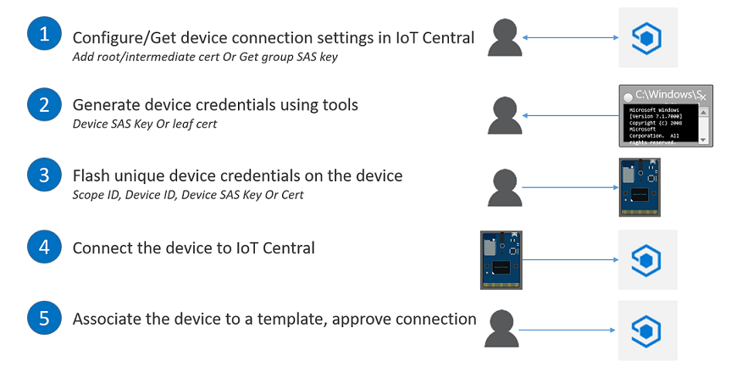
Preferred solution
Device and metadata management
Bulk device registration and device approval in IoT Central
Notes:
When Fabrikam is ready to mass manufacture devices, can they configure their devices to connect to the cloud when turned on automatically, or do they all have to be registered during installation?
The bulk device registration and provisioning steps described in the previous section require Fabrikam to register devices in IoT Central as a first step before any new devices can connect. This works fine when adding tens of devices, but what if they are ready to mass-produce and connect thousands of devices? Fortunately, IoT Central provides a method for connecting devices without requiring the registration step. To do this, Fabrikam generates credentials and configures its devices in the factory. When these devices turn on for the first time, they automatically connect to the IoT Central application. The final step is for an IoT Central operator to approve the device so it can start sending data.
The steps to complete this process are as follows:
Configure and retrieve device connection settings in IoT Central: For X.509 certificate authentication, add and verify the root or intermediate certificate. For SAS, copy the group SAS primary key from the Device Connection page under Administration.
Generate device credentials: For X.509, generate leaf certificates with the root/intermediate certificate added to IoT Central. Use the lower-case Device ID as the CNAME. For SAS, use the dps-keygen command-line tool to generate device SAS keys.
Flash unique credentials on the device: Flash each device with the Scope ID, Device ID, and the X.509 device leaf certificate or SAS key.
Turn on the device: Program the IoT devices with provisioning service information. When a device is first turned on, it connects to DPS to retrieve its IoT Central registration information.
Associate the devices to a template and approve the connection: All devices initially show up under Unassociated devices within IoT Central's Device Explorer with a Registered provisioning status. Associate the devices to a device template and approve them. This changes the provisioning status to Provisioned, allowing them to retrieve a connection string from IoT Hub and start sending data.

Slide 30
Preferred solution
Device and metadata management
IoT Central supports the following protocols:
MQTT
AMQP
HTTPS
What if devices don’t support these protocols?
OPC Unified Architecture (OPC UA) components can connect using the HTTP protocol
Other unsupported protocols like SCADA are incompatible with IoT Central. Consider using an Azure IoT Edge device to perform protocol conversion and potentially pre-processing of data from these devices before sending to IoT Central
You must use the Azure IoT Central Edge Device Bridge module
Notes:
What communication protocols are supported? What if they are using devices that do not support those protocols?
IoT Central supports the following protocols:
MQTT
AMQP
HTTPS
There are many machine-to-machine protocols in use today that are standard across industrial automation industries and manufacturing. Fabrikam is likely using components in their rod pumps that adhere to the OPC Unified Architecture (OPC UA), which uses a high-performance binary protocol (opc.tcp://) or HTTP protocol. If so, these devices can connect to IoT Central using the HTTP protocol, but the binary protocol is typically preferred. Another common protocol is SCADA, which has been in use for years but is incompatible with direct communication to IoT Central. If Fabrikam is required to use devices that are not natively supported by IoT Central, or by extension, IoT Hub, they can use an Azure IoT Edge device to perform protocol conversion. IoT Edge devices can do other things besides protocol conversion, such as pre-processing and analyzing data "at the edge", before sending it to the cloud.
As of this writing, IoT Central does not natively support connecting IoT Edge devices. In the interim, Fabrikam can use an Azure IoT Central Edge Device Bridge module to connect IoT Edge devices. The current limitation is that device communication is unidirectional. This means that Fabrikam will not be able to send cloud-to-device messages to any devices connected to IoT Edge for command and control.

Slide 31
Preferred solution
Device and metadata management
Defining metadata (location, serial #, etc.)
Device management in IoT Central is model-based. This means you just define the metadata properties, and IoT Central handles storing the information and displaying it for you with no programming on your part
The model is the Device Template. This can be applied to groups of devices
Devices use these templates to send telemetry, set properties, receive settings and commands, and appear in visualizations within IoT Central
Developers can write code that runs on their IoT devices to perform these interactions. SDKs are available in C, Python, Node.js, Java, and .NET
Notes:
Is there a way to define common metadata for devices, such as location and serial number? How is this metadata applied to devices, and how can developers set this metadata programmatically?
Device management in IoT Central is model-based. This means that you do not need to program the cloud-end of the solution to ingest, process, and display device information and telemetry. You also do not need to program cloud-to-device message sending at this end of the spectrum. The model refers to what is called a device template in IoT Central. It is with the device template that you define the metadata for a set of related devices:
An IoT device is associated with a device template, allowing it to send telemetry, set properties, receive settings and commands, and appear in dashboards and other visualizations in IoT Central. Fabrikam writes code that runs on their IoT devices to perform these interactions. The code can be written in any language that is compatible with the device platform. However, Azure IoT software development kits (SDKs) can be used to accelerate and simplify device application development. There are SDKs available in C, Python, Node.js, Java, and .NET. Developers use the SDKs to connect devices, send device telemetry, set properties, and receive command messages and settings.

Slide 32
Preferred solution
Device and metadata management – Types of metadata
Measurements | Add fields for the device telemetry, defining the display name, field name (as sent by the device), and data type.
Settings | Settings are used to control a device by providing operators with inputs to the device. For instance, the pump rate can be adjusted by providing a numeric value that gets sent to the pump controller, which it uses to adjust the crank arm rotation rate. Settings can be in one of the three following states: Synced, Pending, and Error.
Properties | Used to specify metadata, such as serial number, location, IP address, or other data associated with a device.
Rules | Apply automated behavior based on device data. Rules are what Fabrikam can use to send alerts when pump telemetry crosses predefined thresholds.
Dashboards | Device-level dashboards that display customized views of the device, like aggregate values over time slices, or a map of the device's location.
Notes:
Is there a way to define common metadata for devices, such as location and serial number? How is this metadata applied to devices, and how can developers set this metadata programmatically?
Measurements: Add fields for the device telemetry, defining the display name, field name (as sent by the device), and data type.
Settings: Settings are used to control a device by providing operators with inputs to the device. For instance, the pump rate can be adjusted by providing a numeric value that gets sent to the pump controller, which it uses to adjust the crank arm rotation rate. Settings can be in one of the three following states: Synced, Pending, and Error.
Properties: Used to specify metadata, such as serial number, location, IP address, or other data associated with a device.
Rules: Apply automated behavior based on device data. Rules are what Fabrikam can use to send alerts when pump telemetry crosses predefined thresholds.
Dashboards: Device-level dashboards that display customized views of the device, like aggregate values over time slices, or a map of the device's location.

Slide 33
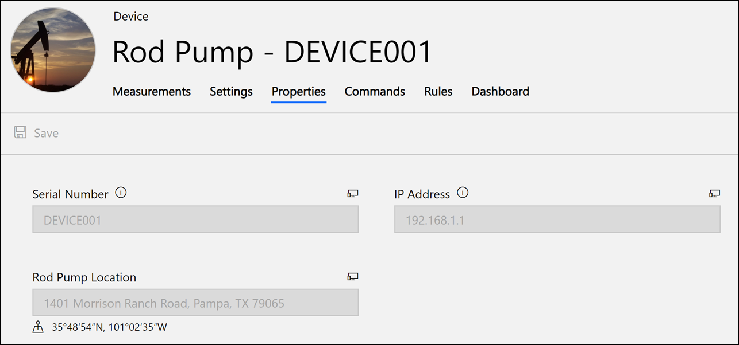
Preferred solution
Device and metadata management – Device template
Notes:
Is there a way to define common metadata for devices, such as location and serial number? How is this metadata applied to devices, and how can developers set this metadata programmatically?
Measurements: Add fields for the device telemetry, defining the display name, field name (as sent by the device), and data type.
Settings: Settings are used to control a device by providing operators with inputs to the device. For instance, the pump rate can be adjusted by providing a numeric value that gets sent to the pump controller, which it uses to adjust the crank arm rotation rate. Settings can be in one of the three following states: Synced, Pending, and Error.
Properties: Used to specify metadata, such as serial number, location, IP address, or other data associated with a device.
Rules: Apply automated behavior based on device data. Rules are what Fabrikam can use to send alerts when pump telemetry crosses predefined thresholds.
Dashboards: Device-level dashboards that display customized views of the device, like aggregate values over time slices, or a map of the device's location.

Slide 34
Preferred solution
Device and metadata management
How can control messages be sent to rod pump controllers from the cloud?
Edit the device template in IoT Central
Add settings and configure commands.
Settings can be anything you want (cycle power, increase fan speed, etc.)
These settings are applied to the device even after it restarts
Supply the setting name, description, field name, and values allowed. Once added, operators can use the Device Explorer to change settings on a device
Develop the IoT device’s application code to watch for commands and perform actions on the device accordingly
Notes:
How can control messages be sent to rod pump controllers from the cloud to perform tasks like turn off the pump engine or change settings?
Use the IoT Central portal to edit a device template to add settings and configure commands.
Settings control a device and allow operators to apply persistent settings to the device through the IoT Central application. These settings, which can be anything you want, such as temperature or fan speed, are applied to the device, even after it restarts. Define a setting by editing a device template, choosing the Settings tab, then entering values for the setting name, description, field name, unit of measure (RPM, psi, etc.), data type (e.g. number, text, date, or toggle), initial value, and minimum or maximum values allowed, if applicable. Once added, an operator can use the Device Explorer to change the setting on a device.
Use commands to run commands on the device remotely from IoT Central instantly. The application code on the IoT device watches for commands sent from IoT Central. When it receives a command, code is executed to perform control actions on that device or other devices to which it has access. For example, create a command to restart the device remotely. Once created, the operator will see the command in the Device Explorer and use it to run the command when the device is connected instantly.

Slide 35
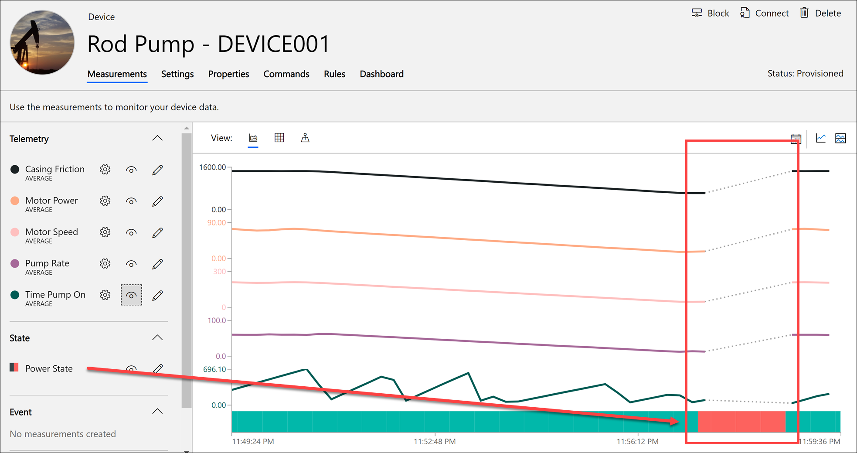
Preferred solution
Notes:
In Fabrikam's case, they want to issue commands to the rod pump controller from the cloud. To do this, Fabrikam created a new command that sends a power cycle command to the controller. Included in the device telemetry is the power state that indicates whether the power to the pump is on. In the screenshot below, the telemetry displayed in the line chart shows a steady decrease in all levels, indicating impending failure. The red box shows the power state change from ON to OFF, including a gap in telemetry, indicated by the dotted lines. When the power cycled back on, the pump's telemetry showed normal operating levels.

Slide 36
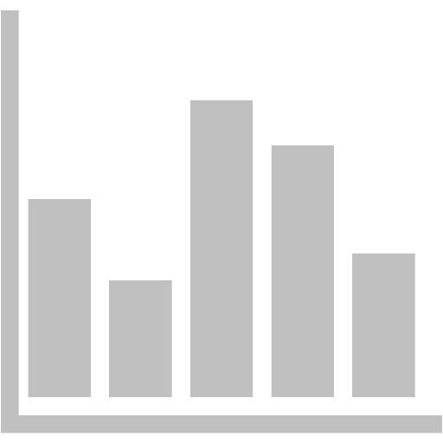
Preferred solution
Dashboards and telemetry analysis
Create visualizations for each rod pump with filtering
IoT Central automatically creates visualizations of telemetry based on the device template
Start by selecting a rod pump in the Device Explorer
Use the Analytics page to view multiple pumps in a single pane
Device’s telemetry items can be shown or hidden
Data can be filtered over periods of time since it’s time-series data
Create shared and personalized dashboards
The IoT Central application’s home page includes a shared dashboard
Tiles can show maps, charts, KPIs, images, etc.
Users can create their own dashboards
Notes:
How would you propose Fabrikam create visualizations for each rod pump? What options are available to view and filter the device telemetry?
By using the recommended IoT Central SaaS product, Fabrikam benefits from automated visualizations of the rod pump telemetry data. They can view the sensor data by selecting a device in the Device Explorer. For more advanced visualizations, including the ability to view telemetry for multiple pumps in a single pane, use the Analytics page.
Each of the device's telemetry items can be displayed or hidden when viewing a device. Since the data is time series-based, there are time filters to show events within predefined time windows or a custom range. Charts are displayed based on the data type, and chart options can be set to adjust the visualizations. Telemetry can also be viewed on a map if there is location-based data. Any location movements are displayed on the map for the filtered time range. Finally, all data can be displayed in a grid.
How can they create shared dashboards, and can users create their own personalized dashboards?
IoT Central includes a shared dashboard on the application's home page. This dashboard is visible to all users and is initially blank when the Custom Application template is used. The dashboard is composed of tiles that can be sized and positioned, and include links, images, labels, device settings and properties, maps, charts, state history, event history, KPIs, and last known value.
Users can create a personalized dashboard by selecting New on the shared dashboard and supplying a name. Only they can see the new dashboard.
Device-level dashboards are configured by editing the device template. This provides an alternative shared dashboard geared toward the device type.

Slide 37



Preferred solution
Dashboards and telemetry analysis
How can this data be used outside of IoT Central?
The continuous data export feature can automatically export data to Azure Blob storage, Azure Event Hubs, and Azure Service Bus
Exported data includes measurements, devices, and device templates
Only data that enters IoT Central after the feature is turned on can be exported, not historical data
Data exported to Azure Blob storage can be used for long-term cold storage and scenarios like training ML models in Azure Databricks
Data exported to Event Hubs or Service Bus can be processed in real time to do things like send notifications or make real-time predictions
Notes:
Can telemetry be automatically exported to external storage for offline batch processing? What other options are available to gain access to telemetry outside of the core IoT solution?
When using IoT Central, all device and telemetry data is stored within underlying Azure services, such as Azure Time Series Analytics, that are hidden from view. You cannot directly access this data beyond the IoT Central application portal interface. However, IoT Central provides a feature called continuous data export to automatically export your data to your own Azure Blob storage, Azure Event Hubs, and Azure Service Bus instances. The data that is available to export includes measurements, devices, and device templates.
It is important to note that the only data that gets exported using this feature is any data added after enabling continuous data export. You cannot retrieve data that existed before turning on the feature. Because of this limitation, you should turn on the feature early.
Using continuous data export enables many integration options, depending on the data target. When you choose Azure Blob storage as the export destination, data is exported to your storage account once per minute, and the files are stored in your selected container in Apache Avro format. The exported files use the same format as the message files exported by IoT Hub message routing to Blob storage. The exported data can be used for cold path processing and analytics like training machine learning models in Azure Machine Learning or Azure Databricks. It can also be used for long-term trend analysis in Microsoft Power BI. The path to landing the telemetry in Power BI involves a handful of Azure services, such as Azure Functions, Azure Data Factory, and Azure SQL Database, but this is just a simple example of one option for adding on a custom workflow to your data.
If you want to have near-real-time access to the data, allowing you to create a hot path for analytics and processing, choose either Azure Event Hubs or Azure Service Bus as the continuous data export target. Many services within Azure can process streaming data from Azure Event Hubs and Azure Service Bus. For example, you can ingest the data into Azure Stream Analytics to perform transformations and aggregates over time windows, and output to a data sink like Power BI or Azure SQL Database. You can perform serverless processing using Azure Functions and output to Event Grid to trigger several downstream consumers like Azure Logic Apps or custom WebHooks.

Slide 38
Preferred solution
Security
Device data encryption and authentication
All data exchanged between IoT devices and IoT Central is encrypted (in transit), and all data stored in IoT Central is also encrypted (at rest)
Fabrikam can use industry-standard X.509 CA certificates for device authentication
Proof-of-possession (PoP) flow is used to combat eavesdropping of certificates by generating random numbers to be signed by Fabrikam’s private keys
Hardware Secure Modules (HSM)-based silicon chips on IoT devices are supported and are the best option to protect private keys
All users sign in to IoT Central with either a Microsoft Account (MSA) or Azure Active Directory account
Users are added through the Users pane under Admin
Notes:
Is device data encrypted both in transit and at rest?
Yes, all data exchanged between IoT devices and IoT Central is encrypted. All data stored in IoT Central is also encrypted.
Can Fabrikam use standard certificates for device authentication? How do Fabrikam's administrators approve new devices that attempt to connect to the cloud?
Yes, Fabrikam can use industry-standard X.509 CA certificates for device authentication. However, merely using the X.509 CA certificate alone does not ensure the absolute security of the devices. As with any digital certificate, its public information is susceptible to eavesdropping. An eavesdropper can intercept the certificate and try to use it as its own, attempting to register their unauthorized device with IoT Central. The IoT Hub portion of the IoT Central architecture combats eavesdropping through a proof-of-possession (PoP) flow, by generating a random number to be signed by Fabrikam, using its private key. This proof-of-possession challenge is part of the X.509 CA registration process when a new device is added. Because of this, Fabrikam must make sure the private keys are protected from outsiders who can use them to pass the proof-of-possession challenge. The best way to protect the keys is to use Hardware Secure Modules (HSM)-based silicon chips in their IoT devices, which are capable of internally generating and protecting private keys. When HSM is used in this fashion, the private keys never see the light of day, securing them from potentially devastating leaks.
If you have not already registered the device that is attempting to connect, it shows up in IoT Central as an Unassociated device on the Device Explorer page. An administrator must associate the device with the appropriate device template and approve it before it can connect to the IoT Central application and send data. An administrator can also block a device through the Device Explorer page so it cannot send data. Blocked devices have a provisioning status of Blocked.
What user management options are available for the dashboards? What roles are defined?
IoT Central simplifies user management by providing a web-based Administration page to add and remove users and assign roles. The user who creates the IoT Central application is automatically added as an administrator. All users must use either a Microsoft Account (MSA) or Azure Active Directory (Azure AD) account to connect to the application. Users are added through the Users pane within the Administration page in the IoT Central application. Azure AD groups are not currently supported. Users can be added in bulk by entering the user IDs separated by semi-colons within the User ID field of the Add User form.
Three roles can be assigned to users:
Administrator: These users have access to all functionality in an application. There must always be at least one user in this role.
Application Builder: Users in this role can do everything in an application except administering the application; they do not have access to the Administration section of the application.
Application Operator: These users cannot make changes to device templates nor administer the application. Operators can add and delete devices, manage device sets, and run analytics and jobs. Operators do not have access to the Application Builder and Administration pages.

Slide 39
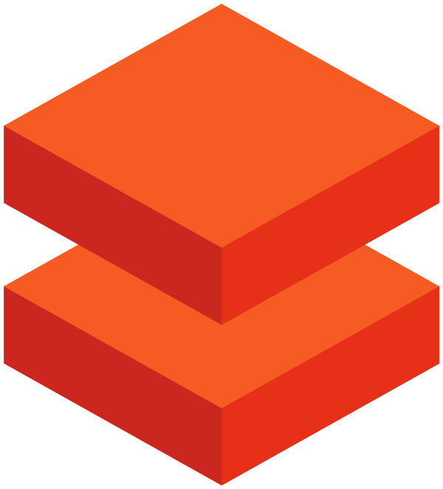
Preferred solution
Alerts and integrations
Train ML model with historical data and deploy it for real-time maintenance predictions
Use Azure Databricks, a powerful Apache Spark platform that can process data at scale, as well as enable data science, data engineering, and support development needs
Features that make this a good choice for Fabrikam:
AAD integration and RBAC
Collaborative features such as workspace and git integration
Run scheduled jobs for automatic notebook/library execution
Train and evaluate Machine Learning (ML) models at scale
Use Azure Machine Learning service to host the trained models and to easily deploy the model for real-time scoring in AKS
Notes:
Fabrikam has historical telemetry data from pumps that operate under normal, gradually failing, and immediately failing conditions. They want to train a Machine Learning (ML) model with this data and use it for real-time anomaly detection. Which platform would you recommend for training and deploying the model?
The recommended platform that meets these needs for this solution is Azure Databricks. When it comes to working with big data in a unified way, whether you process it real-time as it arrives or in batches, Apache Spark provides a fast and capable engine that also supports data science processes, like machine learning and advanced analytics. Built as a joint effort by the team that created Apache Spark and Microsoft, Azure Databricks provides data science and engineering teams with a single platform for Big Data processing and Machine Learning.
There are a lot of features Azure Databricks offers over top of standard Spark installations. The key features that make this a good choice for Fabrikam are:
Integrates with Azure Active Directory for single sign-on and RBAC in certain scenarios.
Contains collaborative features such as the workspace that contains both private and shared folders, integrated change tracking of notebooks and integration with git source control systems like GitHub, and granular user and role-based permissions.
It is possible to start and stop clusters either manually or automatically, based on usage.
Supports running scheduled jobs for executing notebooks and libraries on a schedule.
Fabrikam provided you with sample telemetry and the fields they deem critical for detecting anomalies. They need a way to train and deploy an ML model they can use to make real-time predictions of potential failures, then create alerts and actions on these indicators to prevent damage to failing pump components.
Azure Databricks supports machine learning training at scale. This means that it can handle the historic pump telemetry data, as well as periodically re-training the model on new data stored in Azure Blob storage by IoT Central's continuous data export feature. A large portion of the data will be used for training, and the rest can be used to validate the performance of the trained model.
For model deployment, use Azure Machine Learning service and the Azure Machine Learning SDK to host a trained machine learning model and automatically deploy the model to an Azure Kubernetes Service (AKS) cluster. Creating the AKS cluster is a one-time process for your workspace, where after you can reuse it for multiple deployments as the model gets updated through re-training.

Slide 40
Preferred solution
Alerts and integrations
Enable real-time predictions with the trained model:
Create an Event Hub to collect data from IoT Central in real-time
Enable continuous data export in IoT Central to output to Event Hub
Create Azure Function App with function triggered by Event Hub
Have function send device telemetry to deployed model in AKS
If maintenance issue or failure predicted, perform additional actions
Use Logic Apps or Microsoft Flow to send alerts via email, SMS, CRM, etc. These can be triggered via an HTTP endpoint or queue
Use table storage within a Storage Account to keep track of notifications sent so you don’t flood operators with alerts
Notes:
How can Fabrikam make real-time predictions with the trained model and send alerts if needed? They are interested in available integrations that may work with services they already use, like Office 365 or Dynamics CRM.
The trained ML model is deployed within a web service hosted by AKS, which provides a REST-based HTTP endpoint that accepts pump telemetry data and returns a prediction (true or false) whether the pump should be maintained to avoid possible failure. Although IoT Central does not directly support sending telemetry to an HTTP endpoint, we can use Azure services alongside IoT Central to perform additional processing.
The first step is to create a new Event Hub that will act as a collector for data coming into IoT Central. The receipt of a message into this hub ultimately serves as a trigger to send data into a machine learning model to determine if a pump is in a failing state.
The next step is to configure continuous data export in IoT Central to send data to the Event Hub. Once configured, all new telemetry will be sent to the selected Event Hub for downstream processing.
Next, create an Azure Function App with a function that gets triggered by the Event Hub. Azure Functions enable serverless processing using .NET, Node.js, Python, and PowerShell to handle events on a low-cost and powerful platform. When IoT Central exports the pump telemetry, the data is sent in batches to Event Hub. This transfer of data automatically triggers the function, which receives the data in small batches. The function code should aggregate the data for each pump (by device ID) and send the average value of the sensors of each pump to the deployed model to retrieve the prediction. If a failure is predicted, the function needs to take additional steps to send the alert. Sending the average values of each pump's sensors within the batch reduces the number of times we call the web service.
One of the things we would like to avoid is sending repeated notifications to the workforce in the field. Notifications should only be sent once every few hours per device. To keep track of when a notification was last sent for a device, use a table in a Storage Account. A table provides a simple key/value store, making it fast and efficient for keeping track of whether an alert for the pump has been sent within the configured time period.
There are several options for sending alerts from an Azure function. For a code-free option that uses a visual interface to create a notification workflow, use Azure Logic Apps or Microsoft Flow. These services jointly integrate with hundreds of Azure and 3rd-party services, including Office 365 and Twilio. There are many ways to trigger either a Microsoft Flow or Logic App workflow, including using queues or direct HTTP calls. In this case, we recommend using a queue such as an Azure Storage Queue. Queues add resiliency to your solution by allowing the function to add items to the queue, whether or not the workflow is available to process the alert request, as opposed to attempting to send an HTTP request to a workflow that is disabled or unable to execute due to some sort of failure. Once an alert is queued for a pump, an entry is created in table storage along with a timestamp to prevent sending a flood of notifications.

Slide 41
Preferred objections handling
Is there an out of the box solution we can use to jump-start the creation of the solution? Yes! Azure IoT Central is a SaaS-based, end-to-end IoT platform that allows Fabrikam to quickly create their solution with no cloud-development experience required. If they want more customization and have the required cloud development expertise, they can use Azure IoT solution accelerators to jump-start a PaaS-based solution.
Notes:
Is there an out of the box solution we can use to jump-start the creation of the solution?
Yes! Azure IoT Central is a SaaS-based, end-to-end IoT platform that allows Fabrikam to quickly create their solution with no cloud-development experience required. If they want more customization and have the required cloud development expertise, they can use Azure IoT solution accelerators to jump-start a PaaS-based solution.

Slide 42
Preferred objections handling
We are worried about being constrained by a "black box" if we go with a SaaS solution. Do we have access to all of our collected telemetry we can use for external workloads? Yes, all telemetry can be accessed for external workloads after enabling the continuous data export feature in IoT Central. It is important to remember that data sent to IoT Central before enabling this feature is inaccessible. The data export options include Azure Blob storage, Azure Event Hubs, and Azure Service Bus.
Notes:
We are worried about being constrained by a "black box" if we go with a SaaS solution. Do we have access to all of our collected telemetry we can use for external workloads?
Yes, all telemetry can be accessed for external workloads after enabling the continuous data export feature in IoT Central. It is important to remember that data sent to IoT Central before enabling this feature is inaccessible. The data export options include Azure Blob storage, Azure Event Hubs, and Azure Service Bus.

Slide 43
Customer quote
"When we started looking at SaaS-based IoT solutions, we were worried. Most of these options are either clumsy to work with or locked down too tight for meaningful customizations. We weren't prepared to invest the time and resources to stand up a team of IoT and cloud developers to build our solution from scratch. IoT Central met our needs perfectly, and we were able to get up and running ahead of schedule!“ Peter Guerin, CTO, Fabrikam, Inc.

